Slide 1
TkRibbon: Windows Ribbons for Tk
Georgios Petasis
Software and Knowledge Engineering Laboratory, Institute of Informatics and Telecommunications, National Centre for Scientific Research “Demokritos”, Athens, Greece petasis@iit.demokritos.gr

Slide 2
Overview
The Windows Ribbon framework
Creating a Ribbon
Writing the XAML Markup
Compiling the Markup
Creating the TkRibbon widget
Interacting with the Ribbon
Conclusions – Future work

Slide 3
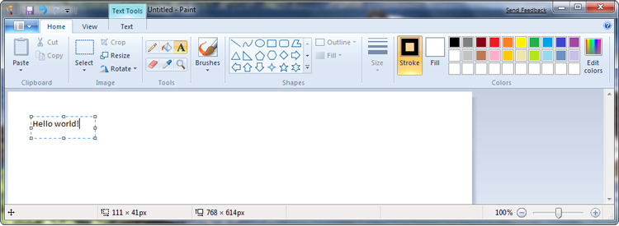
The Windows Ribbon Framework
A new UI paradigm, aiming to unify into a single UI element:
Multilayered menus
Toolbars
Task panes
Paint for Windows 7

Slide 4
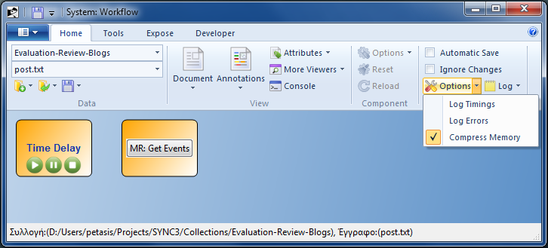
Ribbon UI components
The Ribbon framework consists of two UI components:
The Ribbon command bar, which contains:
The Application menu
A set of standard tabs
A Help button
A rich contextual menu

Slide 5
Ribbons and Applications
Two distinct but dependent development platforms:
A XAML-based markup language, which describes the controls, their properties and their visual layout.
A set of COM C++ interfaces that ensure interoperability between the Ribbon framework and the application.
A Ribbon is actually a COM object:
Attaches to the top part of a window
Redraws window and decoration as needed
Interacts with the user & application

Slide 6
TkRibbon: Ribbons for Tk
TkRibbon provides the needed middleware for:
Loading a resource DLL containing one (or more) Ribbons
Initialise the Ribbon framework
Create a “fake” Tk widget, for occupying the needed space for Tk widget managers
Attach a Ribbon to a Tk toplevel widget
Communicate user actions from the Ribbon to the application
Through Tk virtual events
Send requests to the Ribbon
By invoking widget subcommands

Slide 7
Creating a Ribbon in Tk Ribbon
MARKUP
CODE
Create Ribbon Tk Widget
Compile Ribbon Markup (UICC.exe)
Load Resource DLL
Ribbon Declaration (Markup)
Load Ribbon from Resource DLL
Header .h
Resource .rc
Markup Binary .bml
Markup Binary .bml
Register Command Callback
Link
Register Command Event Handlers
Resource DLL

Slide 8
Writing the XAML Markup (1)
Two major parts:
Definition of commands
Layout of commands in tabs, groups inside a tab, and commands inside a group
Everything is a command
Commands have properties:
Label
Tooltip
Images
etc.

Slide 9
Writing the XAML Markup (2)
<?xml version='1.0' encoding='utf-8'?> <Application xmlns="http://schemas.microsoft.com/windows/2009/Ribbon"> <Application.Commands> <Command Name="cmdExit" Symbol="cmdExit" LabelTitle="Exit" TooltipTitle="Exit" TooltipDescription="Exit Application..." /> </Application.Commands> <Application.Views> <Ribbon> <Ribbon.Tabs> <Tab> <Group> <Button CommandName="cmdExit" /> </Group> </Tab> </Ribbon.Tabs> </Ribbon> </Application.Views> </Application>

Slide 10
Compiling the XML into a DLL
Ribbons are contained in DLLs
Thus, the XAML describing a Ribbon must be compiled
uicc.exe ribbon1.xml ribbon1.bml /header:ribbon1.h \ /res:ribbon1.rc /name:RIBBON1 rc.exe ribbon1.rc link.exe /NOENTRY /DLL /MACHINE:X86 /OUT:ribbon1.dll \ ribbon1.res
// **************************************************************************** // * This is an automatically generated header file for UI Element definition * // * resource symbols and values. Please do not modify manually. * // **************************************************************************** #pragma once #define cmdExit 2 #define cmdExit_LabelTitle_RESID 60001 #define cmdExit_TooltipTitle_RESID 60002 #define cmdExit_TooltipDescription_RESID 60003 #define InternalCmd2_LabelTitle_RESID 60004 #define InternalCmd4_LabelTitle_RESID 60005 #define InternalCmd6_LabelTitle_RESID 60006

Slide 11
Creating the widget (1)
package require Tk package require tkribbon set ScriptDir [file dirname [file normalize [info script]]] ## The resources DLL containing the Ribbon... set RibbonDLL $ScriptDir/ribbon1.dll ## Create a Ribbon widget: set toolbar [tkribbon::ribbon .ribbon -command \ onRibbonUpdatePropertyDispatch] ## Load the resources DLL: must be executed at least once ## for each DLL... $toolbar load_resources [file nativename $RibbonDLL] ## Load the Ribbon UI from the DLL... $toolbar load_ui [file tail $RibbonDLL] RIBBON1_RIBBON ## Pack the widget at Toplevel top: ensure expanding is false! pack $toolbar -side top -fill x -expand false ## Important: The Ribbon will not be drawn, ## unless the window is large enough! wm geometry . 300x250 ;# The minimum size for showing the Ribbon!

Slide 12
Creating the widget (2)
## Events: foreach event {Execute Preview CancelPreview CreateUICommand ViewChanged DestroyUICommand UpdateProperty} { bind $toolbar <<on$event>> \ [list onRibbonEventDispatch $event %d] } proc onRibbonUpdatePropertyDispatch {args} { puts "onRibbonUpdatePropertyDispatch: args: $args" };# onRibbonUpdatePropertyDispatch proc onRibbonEventDispatch {event args} { puts "onRibbonEventDispatch: event: $event, args: $args" };# onRibbonEventDispatch

Slide 13
The result: A Ribbon inside Tk

Slide 14
Interacting with a Ribbon
Three means of interaction:
Through the widget callback
When the Ribbon requests property values
Through virtual events
When an event occurred in the Ribbon
Through widget subcommands invocation
When the application performs a request to the Ribbon

Slide 15
The widget callback (1)
The callback is invoked when a property value is needed, because:
A property is not defined in the XML
A property has been invalidated
Three parameters (at most):
The command id
An integer
The property type
One from: UI_PKEY_Enabled, UI_PKEY_RepresentativeString, UI_PKEY_ItemsSource, UI_PKEY_Categories, UI_PKEY_SelectedItem, UI_PKEY_BooleanValue
The current value (if available)

Slide 16
The widget callback (2)
The callback is expected to return a value
According to the property type
The most complex types relate to galleries
UI_PKEY_Categories
UI_PKEY_ItemsSource
Combo boxes are also galleries!
[list [list categoryName1 ... categoryNameN] {} ] [list [list categoryName1 ... categoryNameN] [list imageResourceId] ] [list [list categoryName1 ... categoryNameN] [list imageResourceId1 ... imageResourceIdN]]
[list [list item1 ... itemN] images-list categories-list ]

Slide 17
Virtual events
<<onExecute>>
Delivered when the user has executed a control
“%d” contains the command id
<<onPreview>>
Delivered when mouse hovers over a command
<<onCancelPreview>>
Cancels an <<onPreview>>
<<onCreateUICommand>>, <<onViewChanged>>, <<onDestroyUICommand>>, <<onUpdateProperty>>
Reserved for future use

Slide 18
Widget subcommand
Many available subcommands
pathname load_resources native-dll-path
pathname load_ui module ribbon-name
Relate to loading a Ribbon
pathname get_property property-type control-id
Retrieve the value of a property
pathname invalidate_state state-property control-id
pathname invalidate_value property control-id
pathname invalidate_property property control-id
Invalidate property aspects, so as new values will be requested

Slide 19
Conclusions – Future work
TkRibbon allows usage of Ribbons from Tk
A large percentage of Ribbon functionality is supported
Future work will concentrate on:
Supporting missing features
Recent Files item list not available
Saving and restoring state of the Quick toolbar
Contextual tabs are supported
But not tested yet
Support for contextual menus missing
Is it important?

Slide 20
Thank you!

