Slide 1
TkGecko: Another Attempt for an HTML Renderer for Tk
Georgios Petasis
Software and Knowledge Engineering Laboratory, Institute of Informatics and Telecommunications, National Centre for Scientific Research “Demokritos”, Athens, Greece petasis@iit.demokritos.gr

Slide 2
Overview
Tk and HTML
Tkhtml & Hv3
Embedding popular browsers
Gecko
TkGecko: embedding Gecko
Examples
Rendering a URL
Retrieving information from the DOM tree
Conclusions

Slide 3
Tk and HTML
Displaying HTML in Tk has always been an issue
This shortcoming has been the motivation for a large number of attempts:
From simple rendering of HTML subsets on the text or canvas widget
i.e. for implementing help systems)
To full-featured Web browsers
like Hv3 or BrowseX
The relevant Wiki page lists more than 20 projects
Does not cover all approaches trying to embed existing browsers in Tk (COM, X11, etc)

Slide 4
Tkhtml
Tkhtml is one of the most popular extensions
An implementation of an HTML rendering component for the Tk toolkit in C
Actively maintained
Supports many HTML 4 features
CCS
JavaScript (through the Simple ECMAScript Engine)
Despite the impressive supported list of features, Tkhtml is missing features like:
Complete JavaScript support
Flash
Java, ...

Slide 5
Embedding popular browsers
Several approaches that try to embed a full-featured Web browser have been presented
Internet Explorer is a popular target (Windows)
Through COM, either with Tcom or Optcl
Under Unix, a similar effort has been made by the Entice project
Which embeds Firefox through the TkXext extension for X11
TkGecko is a similar approach: tries to embed a popular and cross-platform browser
The rendering engine of Firefox was chosen, known as Gecko

Slide 6
TkGecko
Not the first project that tries to embed Gecko
An earlier attempt has been sponsored by a company(Eolas Technologies)
Presented at the 7th Tcl conference (2000)
Closed-source project
Newer TkGecko is open source
Under the BSD license
Sources hosted at SourceForge

Slide 7
Mozilla’s Gecko
Gecko is a cross-platform, standards-compliant and feature-complete rendering engine
Quite popular:
Firefox, Thunderbird, Camino, Flock, SeaMonkey, k-Meleon, Netscape 9, etc.
Quite complex
Its complexity is evident not only by the size of its source code, but also by the effort required in order to embed it in a C++ application
Embedding is performed through XPCOM
A protocol similar to COM

Slide 8
Embedding Gecko
Documentation for embedding Gecko is available
Embedding Gecko is not easy:
Stability of the API: more fluid than stable
Multiple embedding APIs available
A new one has appeared since TkGecko development started (less than a year ago!)
Complexity of the API: functionality scattered among many interfaces
Thread-safety: unknown internal threading model
Dependence upon toolkits: i.e. GTK+ under Linux
The toolkit must be initialised along Tk, and Tk windows to be mapped in windows of the toolkit

Slide 9
TkGecko
TkGecko implements a large percent of the required interfaces
Supporting a wide range of features
The source code is a mixture of static code, and code dynamically generated through SWIG
SWIG is mostly used to interface DOM classes
Building TkGecko is not difficult, due to CMake
Provided that a Development XULRunner SDK is available
Under Linux, GTK+ is initialised in a separate thread, under which Gecko is embedded
Messages are exchanged among this thread and Tk ones

Slide 10
Using TkGecko: an example (1)
CODE
Initialise XPCOM/XUL
Create a TkGecko widget
Register Virtual Events Callbacks
package require Tk package require tkgecko set paths { {C:\Program Files (x86)\Mozilla Firefox\xpcom.dll} {C:\Program Files\Mozilla Firefox\xpcom.dll} /usr/lib64/xulrunner-1.9.1/libxpcom.so /usr/lib64/xulrunner-sdk-1.9.1/sdk/lib/libxpcom.so /usr/lib/xulrunner-1.9.1/libxpcom.so /usr/lib/xulrunner-sdk-1.9.1/sdk/lib/libxpcom.so } set xpcom [tkgecko::initializeXPCOM {*}$paths] puts "XPCOM library: $xpcom"

Slide 11
Using TkGecko: an example (2)
set xuldir [file nativename [file dirname $xpcom]] set appdir {} ;# Same as xuldir... set profiledir [file native [file normalize ~/.tkgecko]] puts "XUL directory: $xuldir" puts "APP directory: $appdir" puts "Profile directory: $profiledir" puts "tkgecko::initializeXUL:\ [tkgecko::initializeXUL $xuldir $appdir $profiledir]" puts ========================================================= puts " Initialisation completed!" puts =========================================================

Slide 12
TkGecko: creating a widget
set URI https://developer.mozilla.org/en-US/ grid [ttk::button .back -text { < } -command onBack] \ [ttk::button .forward –text { > } -command onForward] \ [ttk::button .reload -text {Reload} –command onReload] \ [ttk::entry .uri -textvariable URI] \ [ttk::button .load -text {Load} -command onLoad] \ -padx 2 -pady 2 -sticky snew grid [tkgecko::browser .browser -width 800 \ -height 600 -highlightthickness 1] \ -columnspan 5 -sticky snew -padx 2 -pady 2 grid [ttk::label .status -textvariable STATUS] - - -\ [ttk::progressbar .progress] \ -sticky snew -padx 2 -pady 2 grid columnconfigure . 3 -weight 1 grid rowconfigure . 1 -weight 1

Slide 13
TkGecko: adding bindings
## Bindings: bind .browser <<OnStatusScriptChange>> {set ::STATUS [lindex %d 0]} bind .browser <<OnStatusLinkChange>> {set ::STATUS [lindex %d 0]} bind .browser <<OnStatusChange>> {set ::STATUS [lindex %d 0]} bind .browser <<OnSetTitle>> {wm title . [lindex %d 0]} bind .browser <<OnProgressChange>> {onProgress {*}%d} ## Other virtual events... # bind .browser <<OnLocationChange>> {} # bind .browser <<OnSetDimensions>> {} # bind .browser <<OnStop>> {} # bind .browser <<OnStateChange>> {} # bind .browser <<OnFocusNextElement>> {} # bind .browser <<OnFocusPrevElement>> {} # bind .browser <<OnSetFocus>> {} # bind .browser <<OnRemoveFocus>> {} # bind .browser <<OnVisibilityChange>> {} # bind .browser <<OnShowTooltip>> {} # bind .browser <<OnHideTooltip>> {} bind .browser <<OnDocumentLoadInit>> {onLoadInit {*}%d} bind .browser <<OnDocumentLoadFinish>> {onLoadFinish {*}%d}

Slide 14
Callbacks (1)
proc onLoadInit {args} { puts "<<onLoadInit>>: $args" .progress state !disabled .progress configure -maximum 100 -value 0 };# onLoadInit proc onLoadFinish {args} { puts "<<onLoadFinish>>: $args" .progress state disabled update idle after 1000 {set ::STATUS {}} testDOM };# onLoadFinish proc onLoad {} { .browser navigate $::URI onNewPage };# onLoad | proc onBack {} { .browser back };# onBack proc onForward {} { .browser forward };# onForward proc onReload {} { .browser reload onNewPage };# onReload

Slide 15
Callbacks (2)
proc onNewPage {} { if {[.browser can_go_back]} { .back state !disabled} else {.back state disabled} if {[.browser can_go_forward]} { .forward state !disabled} else {.forward state disabled} };# onNewPage proc onProgress {uri curUriProgress maxUriProgress curTotalProgress maxTotalProgress} { # puts "$curTotalProgress $maxTotalProgress" set curTotalProgress [expr {abs($curTotalProgress)}] set maxTotalProgress [expr {abs($maxTotalProgress)}] if {$maxTotalProgress >= $curTotalProgress} { .progress configure -maximum $maxTotalProgress \ -value $curTotalProgress } };# onProgress

Slide 16
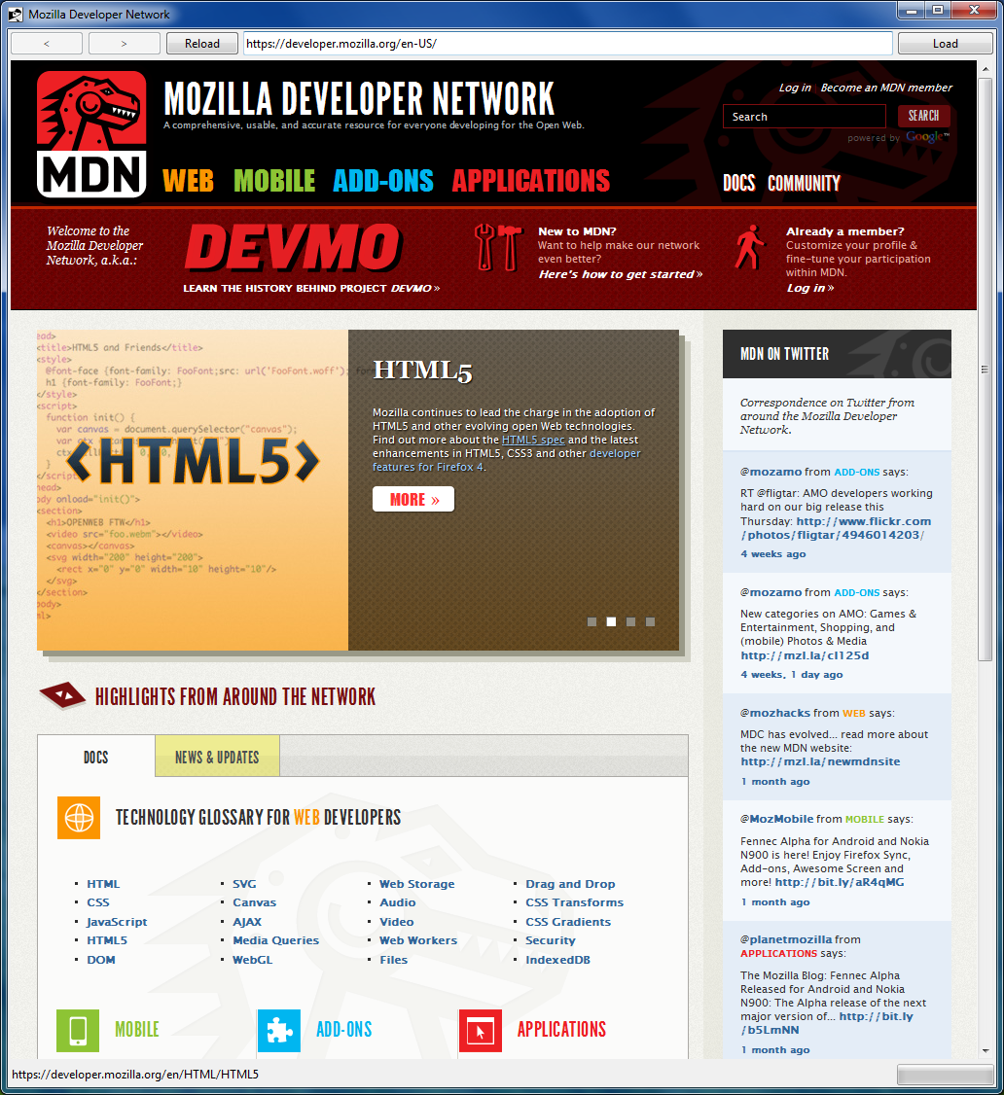
Result

Slide 17
TkGecko widget subcommands
pathname focus_activate
pathname focus_deactivate
pathname navigate URI ?flags?
pathname load
pathname parse ?-base base_uri? ?-mime mime_type? ?--? Data
pathname stop ?flags?
pathname save ?-data_dir data_dir? ?-mime mime_type? ?-flags flags? ?-pflags persist_flags? ?-col wrap_col? ?--? uri

Slide 18
TkGecko and the DOM tree
Extensive support for accessing the DOM tree is provided
nsIDOMHTMLCollection
nsIDOMNodeList
nsIDOMNamedNodeMap
nsIDOMNode
nsIDOMElement
nsIDOMHTMLElement
nsIDOMAttr
nsIDOMDocument
nsIDOMHTMLDocument
nsIWebBrowserPersist
nsIDocumentEncoder
nsIWebBrowserSetup
nsIWebNavigation

Slide 19
Example: retrieving HTML
set dom [$browser document] set body [$dom GetBody] set content [$dom SerializeToString $body] $body –delete $dom -delete

Slide 20
Example: retrieving formatted text
set dom [$browser document] set body [$dom GetBody] set encoder [$dom GetEncoder text/plain 0] if {$encoder ne "NULL"} { $encoder SetNode $body set content [$encoder EncodeToString] $encoder SetNode NULL } else { set content "NULL encoder!" } $body -delete $encoder –delete $dom -delete

Slide 21
Conclusions
TkGecko embeds Gecko under Tk
Supported platforms: Windows and Linux
Basic functionality already available
Displaying HTML
Manipulating DOM tree
Thread safety is an issue
Not tested at all
Some stability issues do exist
Random lockups after a number of pages

Slide 22
Thank you!

