Slide 1
TileQt and TileGtk: current status
Georgios Petasis
Software and Knowledge Engineering Laboratory, Institute of Informatics and Telecommunications, National Centre for Scientific Research “Demokritos”, Athens, Greece petasis@iit.demokritos.gr

Slide 2
Overview
Ttk and support for Windows, OS X and Linux
Qt and GTK+
Mapping between Ttk and other widget toolkits
Interfacing steps
The steps required to interface Ttk to another toolkit
TileQt and TileGTK
Current status
Conclusions

Slide 3
Ttk widgets
Ttk is the best effort so far in providing Tk widgets with native look under all major operating systems
Both Microsoft Windows and Apple OS X offer a native widget set
Along with a suitable API, that applications can use in order to natively draw widgets
Wisely, Ttk fully exploits these APIs
Making native look for Tk applications a reality
But what about Linux?

Slide 4
Ttk and Linux
No native widget set under Linux
Thus, no API that can be called
The Linux desktop is dominated by two environments:
KDE, based on the Qt toolkit library
GNOME, based on the GTK+ toolkit library
Both support styled widgets
But using the style engine for drawing widgets from outside each toolkit is difficult

Slide 5
Qt and GTK+
Both widget toolkits offer a public API
The public API usually targets:
Style development
So as new widget styles or themes can be developed
New widget development
So as new or composite widgets can be developed
TileQt/TileGTK try to use these public APIs in order to draw Ttk widget elements (parts)

Slide 6
Mapping between Ttk and other widget toolkits
TileQt and TileGTK are quite different from each other, implementation wise
However, the problems of interfacing Ttk to another toolkit library (that being Qt, GTK or any other library) are exactly the same
And seem to be independent of the target toolkit library

Slide 7
Interfacing steps (1)
Understand the internals of the library that must be interfaced
A time consuming, but feasible task, if the library sources are available
The sources of both Qt and GTK are publically available, along with sufficient documentation
Understand how to initialise the library from the hosting application
But without initialising the never ending event loop of he library

Slide 8
Interfacing steps (2)
Understand how the toolkit library:
Locates themes
Loads themes
Uses themes in order to draw widget elements
Find a way to map Tk drawables (windows, pixmaps, etc.) to the drawables of the toolkit library, and vice versa
This is an important step, as each library expects its own structures while using its API
Not always easy to achieve through the public API
Native structures are usually abstracted to enhance portability

Slide 9
Interfacing steps (3)
Find a way to map Ttk widget states to the ones supported by the target toolkit library
Not always a straight-forward mapping
Mapping differences usually result in visual differences
Separate widgets whose elements can be drawn directly from widgets that are drawn as a whole
Widgets of the latter category must:
Drawn in an offline pixmap
Segmented in elements, using available pixel metrics
Elements of interest copied back to Ttk window
Segmentation is a vulnerable process
Rarely exact element dimensions can be retrieved

Slide 10
Interfacing steps (4)
Ensure thread-safety
Easy task if the target toolkit library is already thread safe (i.e. Qt)
More tricky if it is not (i.e. GTK, where widgets must be created/drawn only by the thread the library was initialised)
Cope with the large number of available themes for each toolkit library
Problems range from different layouts to wrong pixel metrics

Slide 11
TileQt: a Ttk interface to the Qt widget toolkit
One of the first C/C++ extensions that attempted to provide a Ttk theme, based on the Ttk public API, without being part of Ttk
Development started in 2003
Initially supporting Qt 3.x at that time
Compiling TileQt was never easy
As the build system was not robust for quite some time
Currently, TileQt:
Has substantial support for Qt 3.x/4.x
Uses a build system based on CMake

Slide 12
TileQt: supported widgets
Widget | Qt 3.x | Qt 4.x | Widget | Qt 3.x | Qt 4.x
Background | ☑ | ☑ | LabelFrame | ☑ | ☑
Button | ☑ | ☑ | NoteBook | ☑ | ☑
CheckButton | ☑ | ☑ | TreeView | ☑ | ☑
RadioButton | ☑ | ☑ | Progress | ☑ | ☑
MenuButton | ☑ | ☑ | Paned | ☑ | ☑
ToolButton | ☑ | ☑ | SizeGrip | ☑ | ☑
Entry | ☑ | ☑ | ScrollBar | ☑ | ☒
ComboBox | ☑ | ☑ | Scale | ☑ | ☒

Slide 13
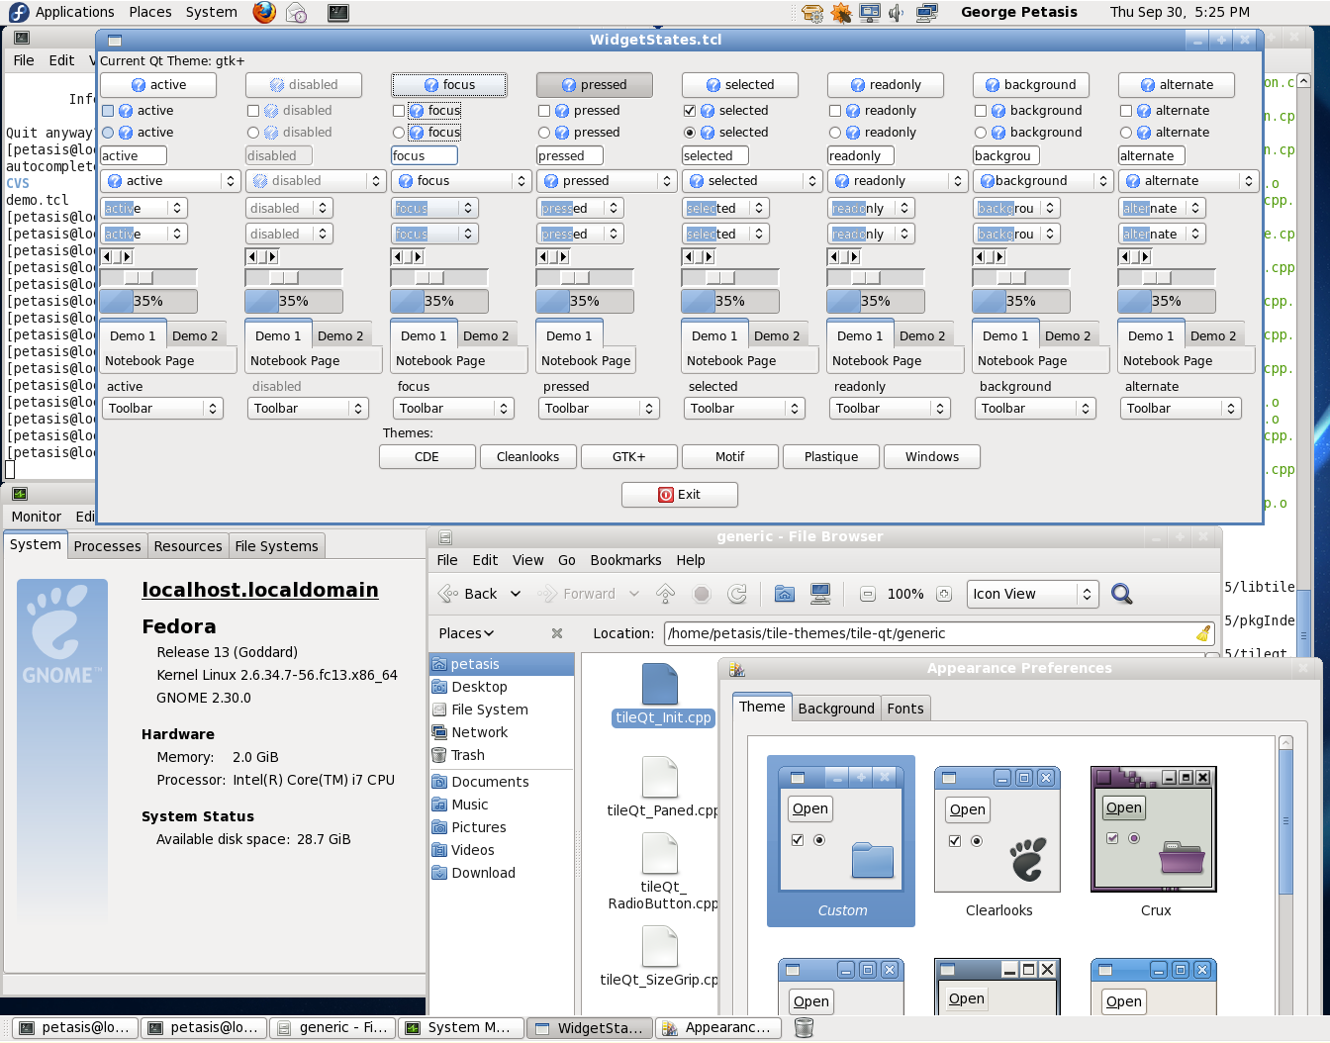

Slide 14
TileGTK: a Ttk interface to the GTK+ toolkit
A far more recent extension, as development started in 2008
TileGTK was based on the expereince obtained from TileQt
In fact, development started by search/replace of Qt to GTK, followed by an gradual adaptation of widgets ☺
Compiling TileGTK has always been easy
As the CMake build system was also inherited

Slide 15
TileGTK and a GTK in C
GTK+ is written in C, which makes presents an interesting opportunity:
To access the GTK+ API through stubs!
No need to link with GTK+
Which may result in distributing TileGTK binaries under the BSD license
However, currently Glib facilities are used in order to load and initialise the GTK+ library
It would have been better if Tcl offered similar capabilities ☺
For the time being, TileGTK binaries are covered by GPL

Slide 16
TileGTK: supported widgets
Widget | GTK 2.x | Widget | GTK 2.x
Background | ☑ | LabelFrame | ☑
Button | ☑ | NoteBook | ☑
CheckButton | ☑ | TreeView | ☒
RadioButton | ☑ | Progress | ☑
MenuButton | ☑ | Paned | ☑
ToolButton | ☑ | SizeGrip | ☑
Entry | ☑ | ScrollBar | ☑
ComboBox | ☑ | Scale | ☑

Slide 17
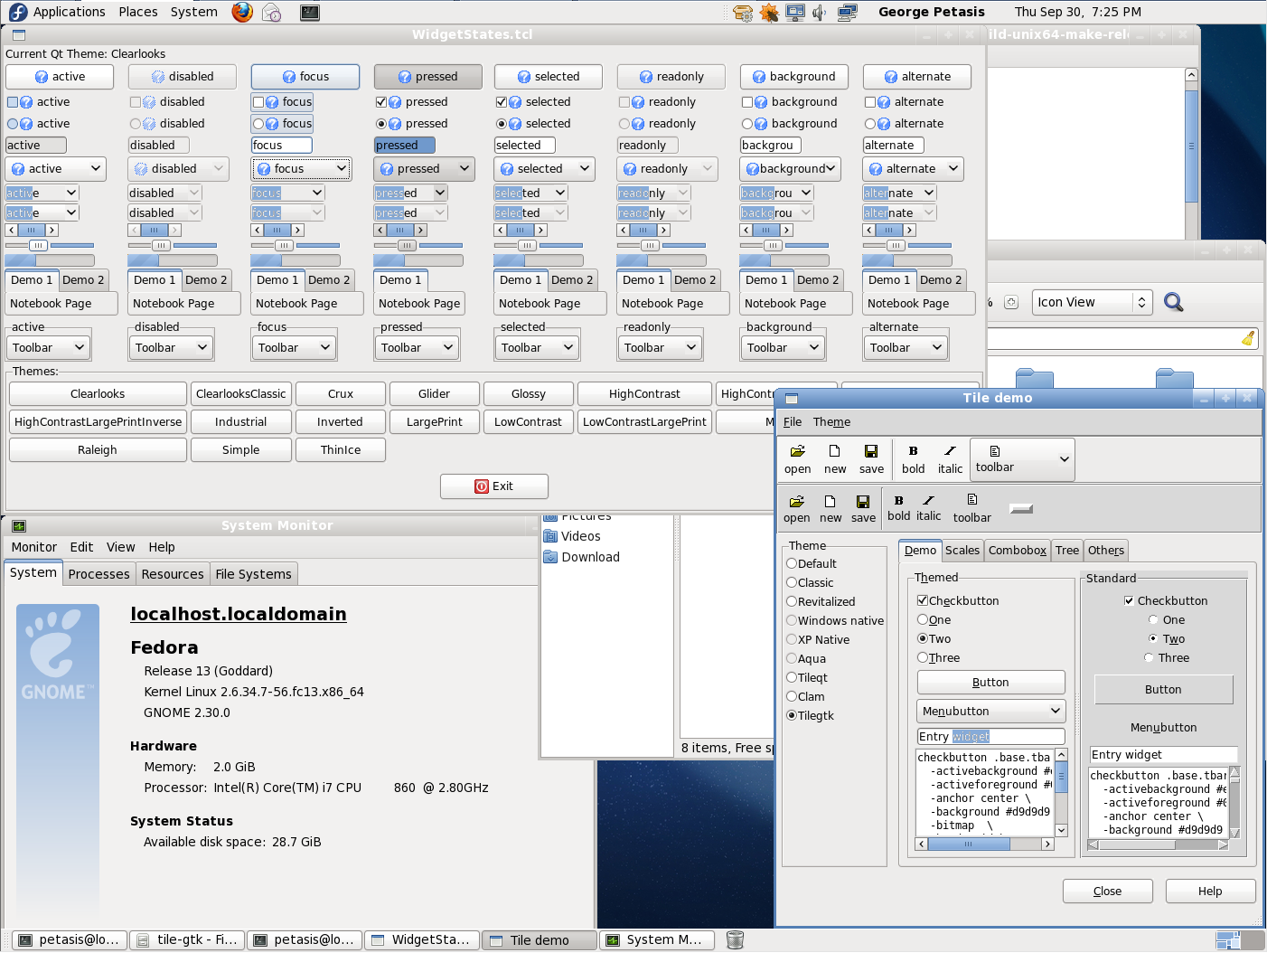

Slide 18
Conclusions (1)
TileQt & TileGTK try to interface Qt & GTK+ to Ttk
Both extensions are not actively maintained
Mainly because Linux usage by the main author constantly diminishes
Both TileQt & TileGTK compile and run with recent Tcl versions
Tested with ActiveTcl 8.6 beta 3 on an updated Fedora 13 system
However loading TileQt/TileGTK in a second interpreter seems to crash wish
No idea why, it used to work

Slide 19
Conclusions (2)
Some widgets are missing:
Separators
Scrollbars/Scales (for Qt 4.x)
Treeview (for GTK+ 2.x)
Several visual differences between TileQt/TileGTK and Qt/GTK+
TileGTK has more differences
TileQt is missing an essential widget (scrollbars)
Both extensions try to retrieve the colour scheme from the corresponding toolkit
Even for GTK+ who has no such capability

Slide 20
Thank you!

