Slide 1
iTcl and TclOO From the perspective of a simple user
Georgios Petasis
Software and Knowledge Engineering Laboratory, Institute of Informatics and Telecommunications, National Centre for Scientific Research “Demokritos”, Athens, Greece petasis@iit.demokritos.gr

Slide 2
Overview
The shock of Tcl 8.6
Porting existing code to TclOO
Case study: the Ellogon NLP platform
iTcl facilities in TclOO
Organisation of classes in Ellogon
Creating an Annotation Tool
Concatenating Dialogs
Conclusions

Slide 3
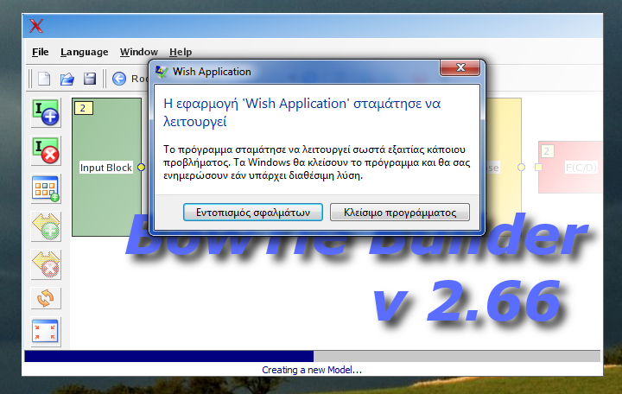
iTcl and Tcl 8.6
Assume an application that uses Itcl
What happens if it is run under ActiveTcl 8.6 beta?

Slide 4
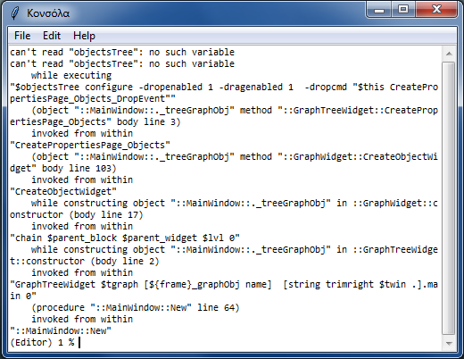
iTcl and Tcl 8.6
Ok, this happens as iTcl 3.4 is loaded in 8.6
Lets compile Tcl from sources (CVS HEAD 27/Jul/10)
Tcl now contains a new iTcl implementation (4.0b4)

Slide 5
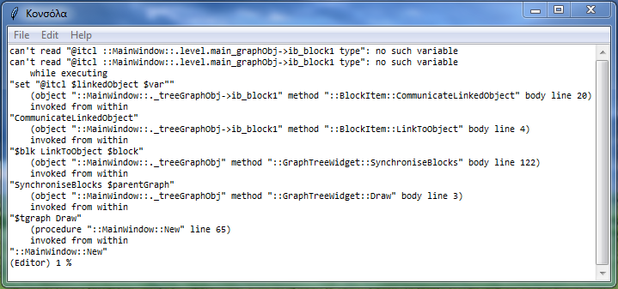
iTcl and Tcl 8.6
Ok, iTcl 4.0 has a problem with a variable
Lets “correct” this
variable objectsTree {}
method CreatePropertiesPage_Objects {} {
chain
catch {
$objectsTree configure -dropenabled 1 -dragenabled 1 \
-dropcmd "$this CreatePropertiesPage_Objects_DropEvent“
}
};# CreatePropertiesPage_Objects

Slide 6
iTcl and Tcl 8.6
iTcl object variables not supported?
It seems no…
but, object naming was internal
iTcl 4.0 has been actively maintained!
Significant progress since last test (6-8 months ago)
Does not crash
A few “rough edges” remain
But:
Support for iTcl object variables seems missing
Status of iTcl next generation?
Unknown. Not working either in previous tests

Slide 7
iTcl and Tcl 8.6
Alternatives for running the application?
Wait until iTcl 4.0 is ready
Will it support 3.4 object variable naming?
Port the code from iTcl to TclOO
Hm, 41 classes? ~20.000 lines of code?
Such a task needs to be automated
Stick to Tcl 8.5 and iTcl 3.4
But what happens with open source applications?

Slide 8
Overview
The shock of Tcl 8.6
Porting existing code to TclOO
Case study: the Ellogon NLP platform
iTcl facilities in TclOO
Organisation of classes in Ellogon
Creating an Annotation Tool
Concatenating Dialogs
Conclusions

Slide 9
Porting from iTcl to TclOO (1)
A medium sized application: Ellogon
Open source (LGPL), http://www.ellogon.org
Sticking to Tcl 8.5 is not an option
But ~480 iTcl classes need to be ported!
Different “variable” syntax
The “my” keyword when calling methods
Different method exporting convention
…
Where is TclOO documentation?

Slide 10
Porting from iTcl to TclOO (2)
Largely a manual (and time consuming) effort
A helper Tcl script to perform “easy” substitutions
Several months were needed
But, a few portions could not be ported
TclOO has some limitations
Or do I have a bad programming style? ☺
The task is now largely finished
And the helper Tcl script got quite complex
And what about other applications?
How about turning the conversion script into an iTcl emulator?

Slide 11
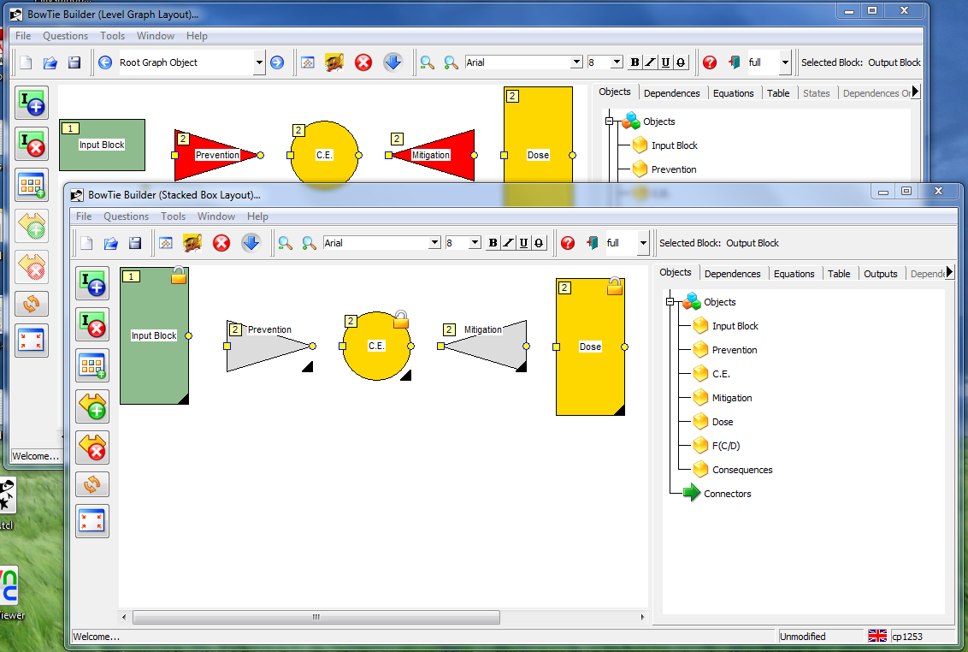
Porting from iTcl to TclOO (3)
The distance of a script that reformats code from an emulator is a simple “eval” ☺
I have created a small package that emulates iTcl
630 lines of code
Ignores less essential features (like protection)
The goal is to get my applications running

Slide 12
Porting from iTcl to TclOO (4)
A quick and simple approach actually
Test application executes further than latest iTcl 4.0
iTcl 3.x object variable references (“@itcl …”) are converted to TclOO equivalent
But:
Not all code substitutions are performed
Adding the “my” keyword to existing code is tricky
4 regular expressions are not enough to handle this
A package that “parses” Tcl is not available
Finally I gave up
no regular expressions for some cases

Slide 13
Porting: Differences (1)
Most notable differences between the two extensions:
No configure/cget on TclOO objects
No common variables across objects of the same class in TclOO
No “static” class methods (methods that do not require an object to be called) in TclOO
Different semantics for variables
A specific method in the classes hierarchy of an object cannot be called in TclOO
TclOO requires the keyword “my” while calling methods from inside of an object

Slide 14
Porting: Differences (2)
Most notable differences between the two extensions:
TclOO automatically exports methods that start with a lowercase letter
No facility for “local” to procedures objects (like itcl::local) in TclOO

Slide 15
Porting: Similarities
iTcl | TclOO
method | my method
$this | [self]
chain | next
itcl::scope | my varname
inherit | superclass
itcl::body | oo::define body
Interesting features of TclOO
Everything subclasses oo::object
“mixin”s
“unknown” on objects
The “my” keyword

Slide 16
Overview
The shock of Tcl 8.6
Porting existing code to TclOO
Case study: the Ellogon NLP platform
iTcl facilities in TclOO
Organisation of classes in Ellogon
Creating an Annotation Tool
Concatenating Dialogs
Conclusions

Slide 17
Case study: the Ellogon NLP platform
Ellogon is an infrastructure for natural language processing
Provides facilities for managing corpora
Provides facilities for manually annotating corpora
Provides facilities for loading processing components, and apply them on corpora
Development started in 1998
I think with Tcl/Tk 8.1
~500.000 lines of C/C++/Tcl code
A lot of legacy code, especially in the GUI
No widespread use of tile/ttk
No OO (i.e. iTcl) in most parts of the code

Slide 18
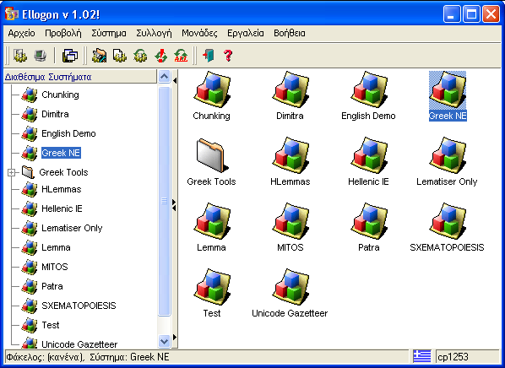
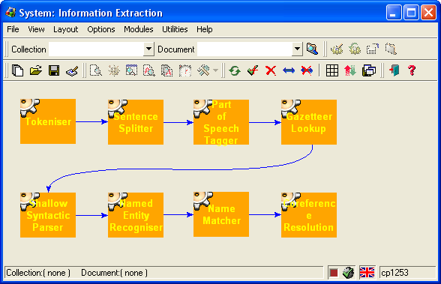
Ellogon Architecture
Language Processing Components
Graphical Interface
Internet
(HTTP, FTP, SOAP)
Operating System Services
(ActiveX, COM, DDE)
Database Connectivity
(ODBC)
…
Services
Collection – Document Manager
C++ API
C API
Storage Format Abstraction Layer
Operating System
XML
Ellogon
Databases
???

Slide 19
Ellogon: plug-ins in many programming languages
Ellogon
Direct Link
C/C++ Components
Java VM
Java Components
CDM API
Tcl Components
Tcl VM
Perl VM
Perl Components
Python VM
Python Components

Slide 20
The roadmap for Ellogon 2.0
The goals for Ellogon 2.0 are:
Make Ellogon’s core thread safe (done)
Make Ellogon multi-threaded (feasible?)
How Ellogon & the Tcl thread model can cooperate?
Modernise GUI (using OO and ttk widgets)
~30% completed
Initially written in iTcl, now ported to TclOO
Includes a complete rewrite of Annotation Tools of Ellogon

Slide 21
Annotation Tools: polymorphism required
Annotation tools is a very demanding area
A lot of tasks that need annotated corpora
Each task, may have its own annotation scheme
Each group, may pose different requirements for the tool
The first generation of tools was:
coded in plain Tcl/Tk
difficult to adapt/extend

Slide 22
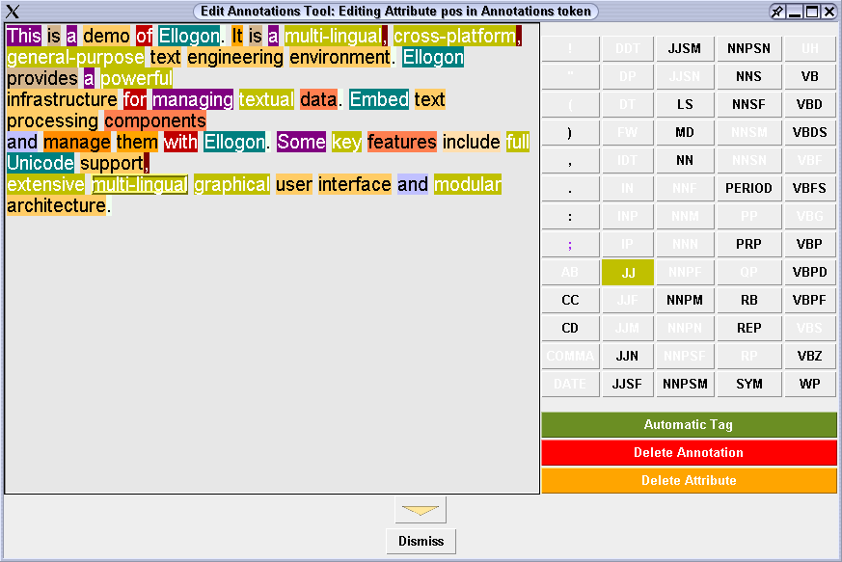
First generation tools (1)

Slide 23
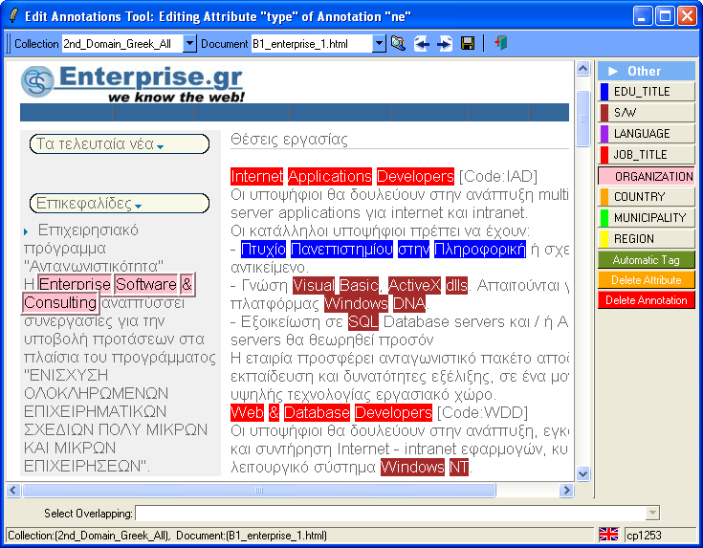
First generation tools (2)

Slide 24
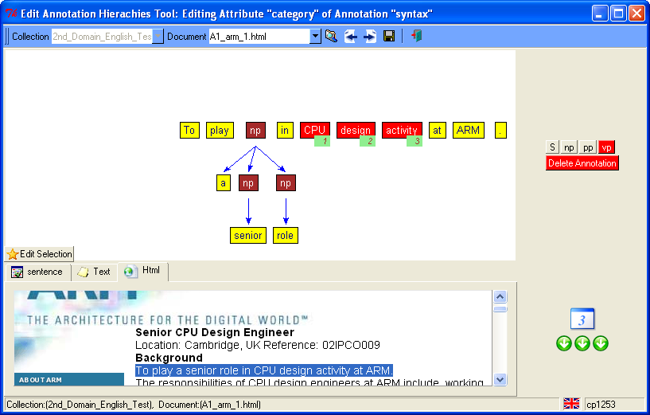
First generation tools (3)

Slide 25
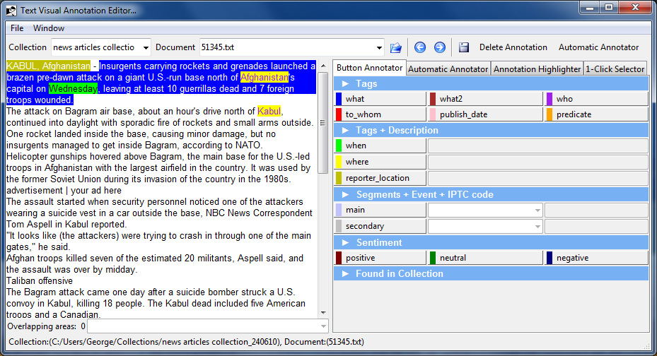
Second generation tools (1)

Slide 26
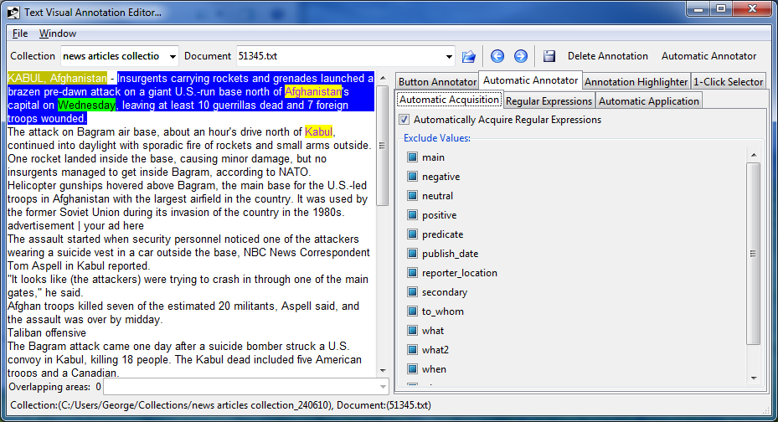
Second generation tools (2)

Slide 27
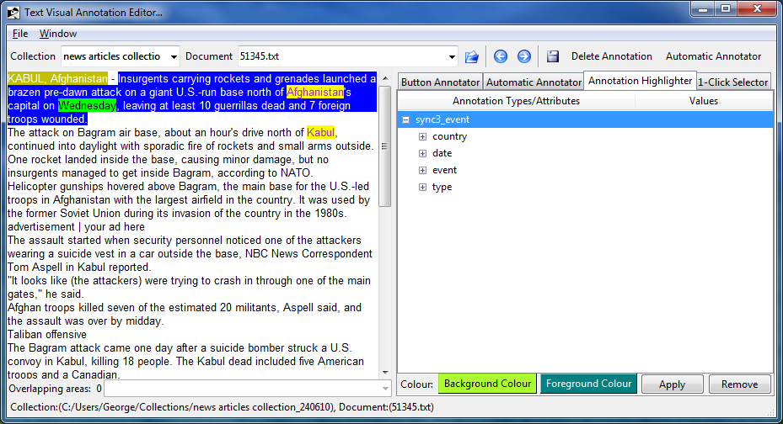
Second generation tools (3)

Slide 28
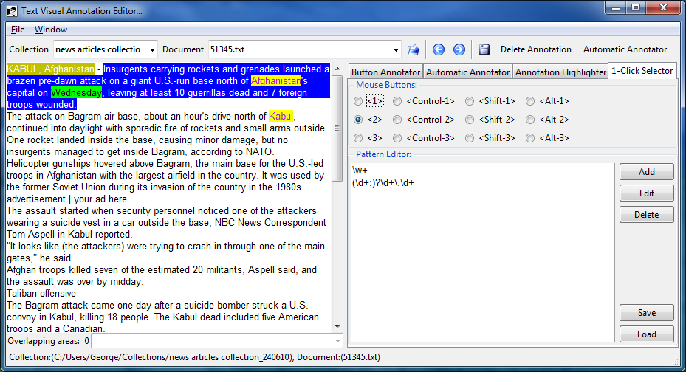
Second generation tools (4)

Slide 29
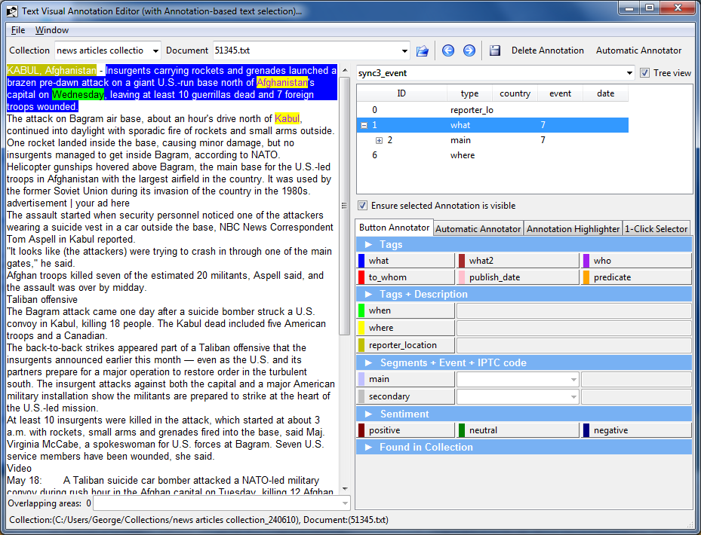
Second generation tools (5)

Slide 30
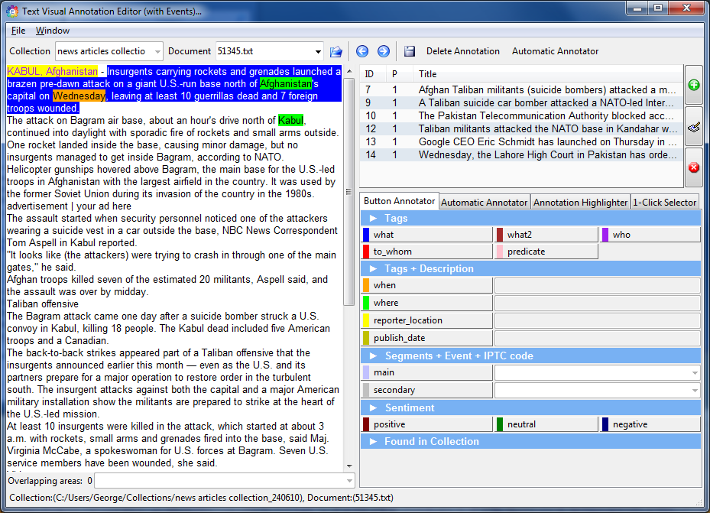
Second generation tools (6)

Slide 31
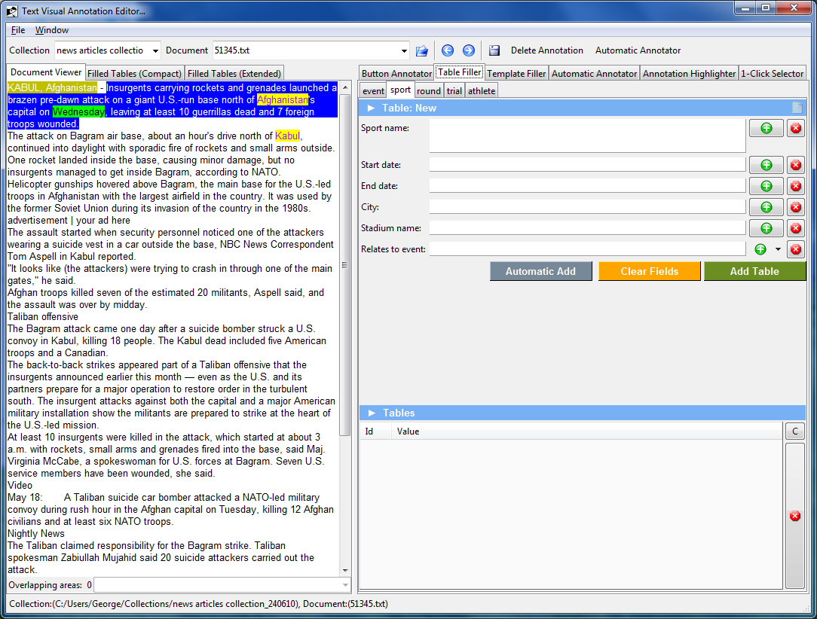
Second generation tools (7)

Slide 32
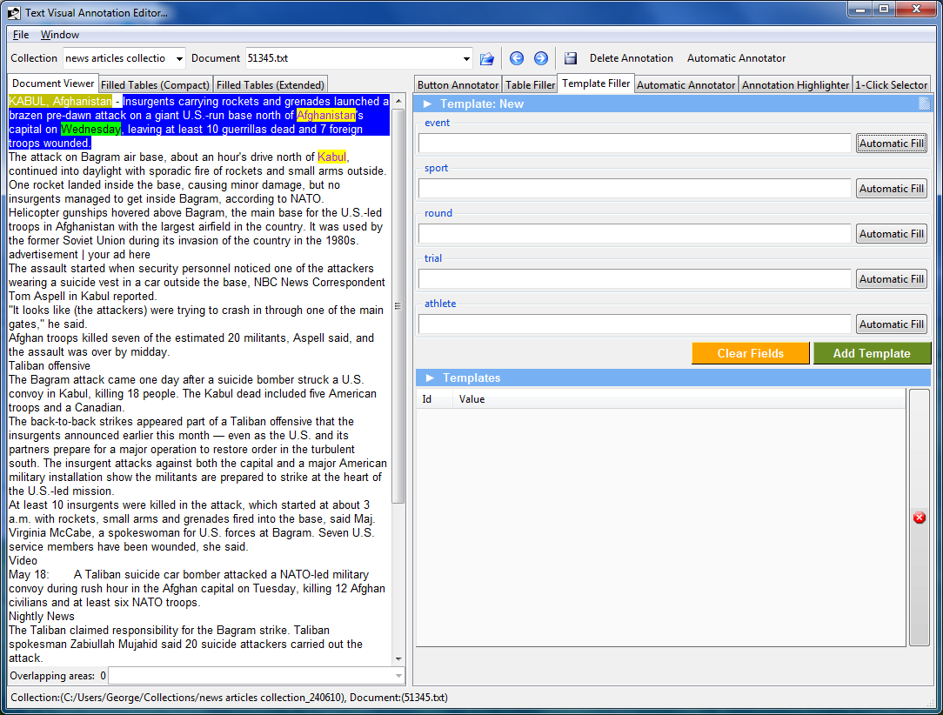
Second generation tools (8)

Slide 33
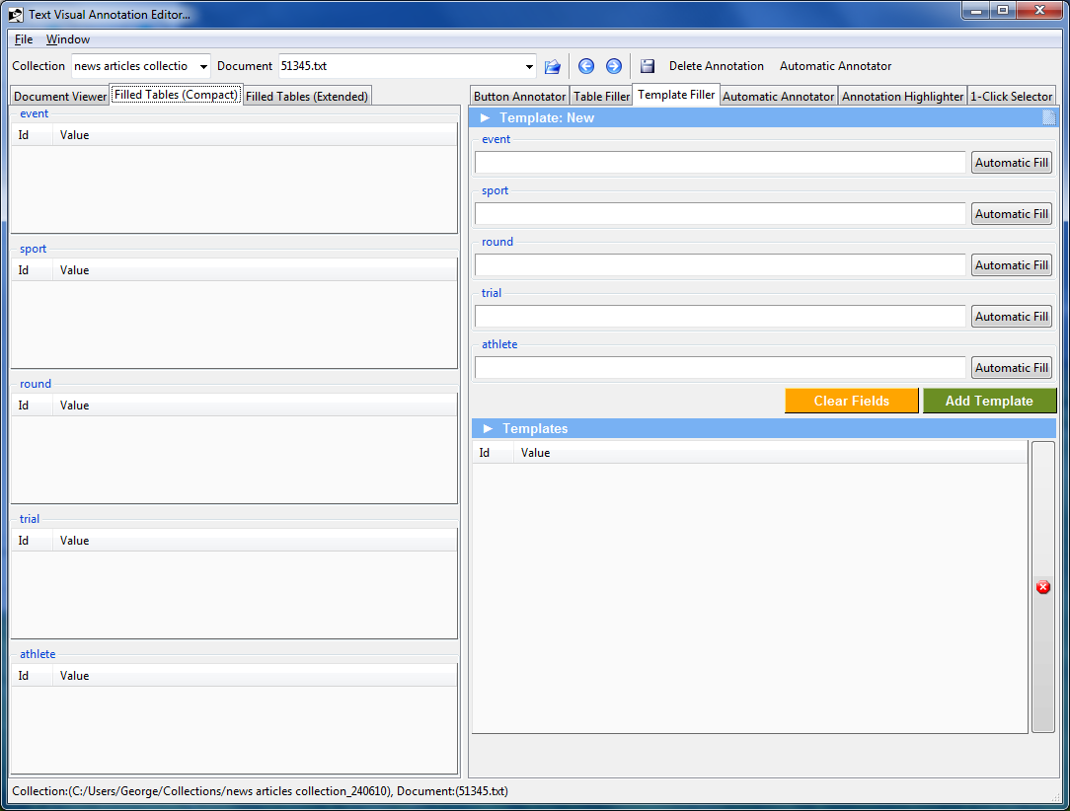
Second generation tools (9)

Slide 34
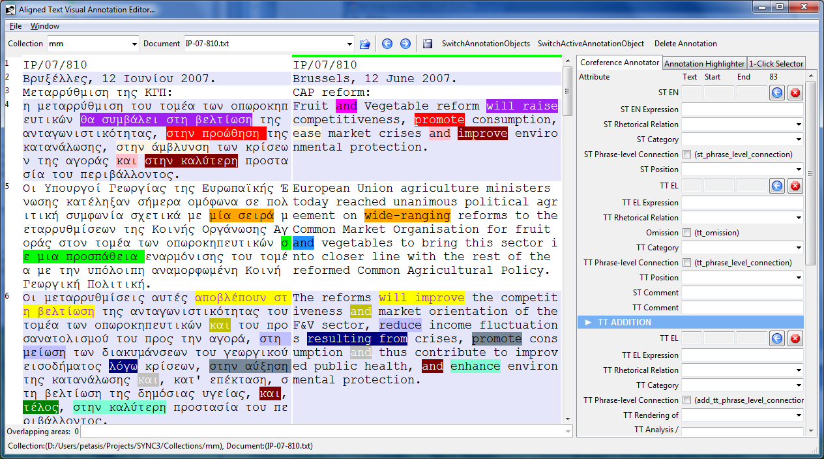
Second generation tools (10)

Slide 35
Classes Decomposition (1)
ToplevelWindow
DocumentSelector
TextWidgetDisplay
EventDefiner
ButtonAnnotator

Slide 36
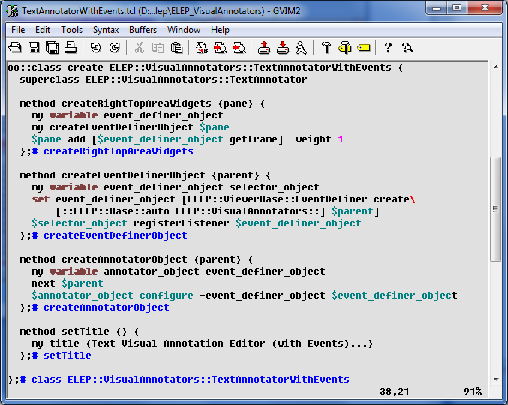
Classes Decomposition (2)
ToplevelWindow
DocumentSelector
TextWidgetDisplay
EventDefiner
ButtonAnnotator

Slide 37
Overview
The shock of Tcl 8.6
Porting existing code to TclOO
Case study: the Ellogon NLP platform
iTcl facilities in TclOO
Organisation of classes in Ellogon
Creating an Annotation Tool
Concatenating Dialogs
Conclusions

Slide 38
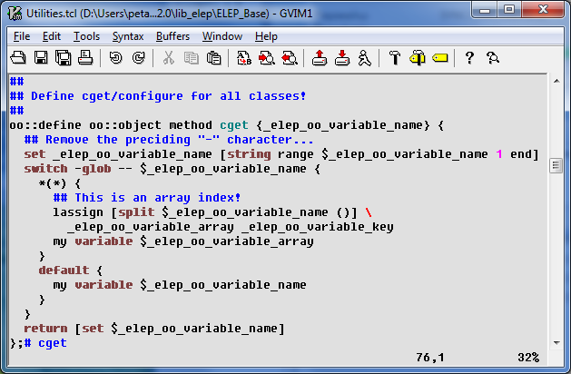
Ellogon TclOO classes: cget/configure
Add cget/configure on all classes
No need for a complex implementation of configure/cget
I only use them to get/set variable values
Very easy to add new methods on all objects!
Everything is a child of oo::object
Simple implementation
oo::define oo::object method cget {name} {
set name [string range $name 1 end]
my variable $name; return [set $name]
};# cget

Slide 39
Ellogon TclOO classes: common (1)
TclOO has another trick:
Procedure oo::define::<name> extends oo::class
Implementing ::oo::define::common allows to use the keyword “common” during class creation
proc ::oo::define::common {varname args} { if {[llength $args] > 1} { … } # Get the name of the current class set cls [lindex [info level -1] 1] oo::define $cls self export varname; # Export method varname # Initialise the variable if {[llength $args]} { set [$cls varname $varname] [lindex $args 0] }
};# ::oo::define::common

Slide 40
Ellogon TclOO classes: common (2)
But common also needs a method to be called from methods accessing common variables
oo::define oo::object method common {args} {
if {![llength $args]} return
set callclass [lindex [self caller] 0]
oo::define $callclass self export varname
foreach vname $args {
lappend pairs [$callclass varname $vname] $vname
}
uplevel 1 upvar {*}$pairs
};# common
Common and my cget/configure do not mix

Slide 41
Ellogon TclOO classes: class methods (1)
## Define "classmethod"...
proc ::oo::define::classmethod {name {args ""} {body ""}} { # Code from: http://wiki.tcl.tk/21595#pagetoce30e53a1 set argc [llength [info level 0]] if {$argc == 4} { uplevel 1 [list self method $name $args $body] } elseif {$argc == 3} { return -code error "..." } # Get the name of the current class set cls [lindex [info level -1] 1] # Get its private "my" command set my [info object namespace $cls]::my # Make the connection by forwarding tailcall forward $name $my $name };# ::oo::define::classmethod

Slide 42
Ellogon TclOO classes: class methods (2)
What about inheritance?
oo::class create ELEP::Base::Utilities {
classmethod userAppDir {} {...}
}
oo::class create ELEP::System::System {
superclass ELEP::Base::Utilities
classmethod systemConfigurationDir {} {
return [my userAppDir]/Systems/Config
};# systemConfigurationDir
unknown method "userAppDir"

Slide 43
Overview
The shock of Tcl 8.6
Porting existing code to TclOO
Case study: the Ellogon NLP platform
iTcl facilities in TclOO
Organisation of classes in Ellogon
Creating an Annotation Tool
Concatenating Dialogs
Conclusions

Slide 44
Widget classes (1)
In Ellogon, I don’t think in terms of Tk widgets
In fact, I totally ignore them
Only 3 classes available, which represent widgets
Toplevel, Dialog, Widget, RibbonToplevel
RibbonToplevel has a Windows Ribbon instead of a menu
Some common methods for all classes
getToplevel
getToplevelObject
getClientArea
Automatic variables
win for toplevel/dialogs
widget for widgets

Slide 45
Widget classes (2)
Widgets are destroyed when objects are deleted, and vise versa
In a way similar to iTk
Toplevel/Dialogs generate widgets based on the object names
Objects of the Widget class need the widget type and name
i.e. Widget ttk::button .button ?args?

Slide 46
Ellogon building blocks
Many building blocks that inherit Widget
Only the Tk widget that will contain the block is required (the “parent”)
i.e. ButtonAnnotator, 1-Click selector, TemplateFiller, TextViewer, HTMLViewer, AllignedTextViewer, etc.
A generic class that represents an Annotation tool
Inherits from Toplevel
Splits client area into two columns, separated by a ttk::panedwindow
All tools, subclass this class, add another layout if required, and create/place building block objects

Slide 47
Overview
The shock of Tcl 8.6
Porting existing code to TclOO
Case study: the Ellogon NLP platform
iTcl facilities in TclOO
Organisation of classes in Ellogon
Creating an Annotation Tool
Concatenating Dialogs
Conclusions

Slide 48
Creating an Annotation Tool
Gluing building blocks is easy, but what about the user experience?
Lets see an example, by creating an Annotation tool that annotates a document with a semantic model (i.e. an ontology)
For this task, the bits required are:
An annotator to annotate “properties” found in the text
An annotator to group properties into objects
An annotator to group objects into other objects

Slide 49
Annotating properties: the button annotator (1)

Slide 50
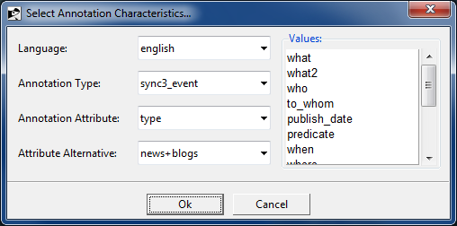
Annotating properties: the button annotator (2)
Cooperates with a viewer (text, HTML, Aligned text, Aligned HTML) and allows the user to annotate the selected text with one or more properties
The annotation schema is dynamic
Method createSpecificationSelectorObject()
Creates an AnnotationSpecificationSelector object
Method show()
Calls AnnotationSpecificationSelector.show() and waits for an answer
Various schemas are read from an XML file, and presented to the user
Button annotator adapts to the selected schema

Slide 51
Grouping properties/objects
The TemplateFiller annotator
Again presents a dynamic schema
Now method createSpecificationSelectorObject()
Creates an AnnotationAndTemplateSpecificationSelector object
How easy is to mix the two annotators?
Easy, just create the two objects and place them on a single annotation tool
Any disadvantages?
Yes. The user gets two dialogs for configuring a single tool!

Slide 52
The multiple dialog issue
How can this be resolved?
A new class must be created, which is the concatenation of the two configuration dialogs
The two objects must somehow create and use the same configuration object

Slide 53
Overview
The shock of Tcl 8.6
Porting existing code to TclOO
Case study: the Ellogon NLP platform
iTcl facilities in TclOO
Organisation of classes in Ellogon
Creating an Annotation Tool
Concatenating Dialogs
Conclusions

Slide 54
Concatenating dialogs (1)
In iTcl was very easy:
Create a new class that inherits the two configuration objects
iTcl has the ability to call explicitly methods from the class hierarchy:
Method populateDialogFrame() just creates two ttk::labelframe and calls populateDialogFrame() of the two inherited classes with the proper parent frame.
In TclOO the task is far more complex!
You cannot simply inherit both classes

Slide 55
Concatenating dialogs (2)
The best alternative?
Create a new class that behaves as both configuration selectors, and drives instances of the two selectors internally
The new class must have all methods of the two objects
The new class must have all the public variables of both objects (so as cget/configure to work)

Slide 56
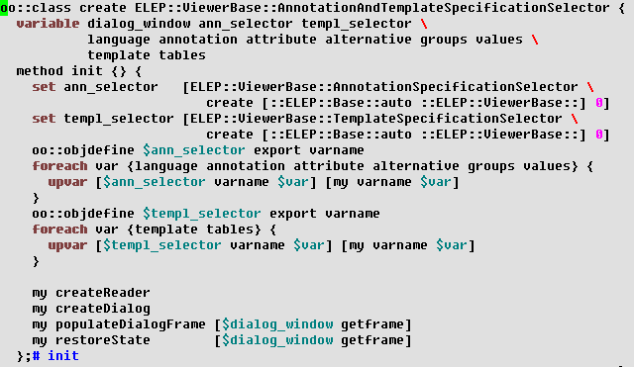
Exposing variables of contained objects
Declare all variables as “automatic”
i.e. in class, with the “variable” keyword
Use “upvar” to link variables between two objects

Slide 57
Exposing methods of contained objects
Methods from both contained objects must be exposed - through “unknown”
method unknown {args} { ## Try to call the aggregated objects... if {![catch {$ann_selector {*}$args} result]} { return $result } if {![catch {$templ_selector {*}$args} result]} { return $result } next unknown {*}$args };# unknown

Slide 58
Problems solved?
So, are all problems solved?
No
Each class stores state information in the configuration array of the application, using a key based on the class name.
method saveState {} { $ann_selector saveState $templ_selector saveState };# saveState method restoreState {frame} { $ann_selector restoreState $frame.annotation $templ_selector restoreState $frame.template };# restoreState

Slide 59
What about efficiency?
Is there a problem using unknown to “distribute” method calls to the proper object?
I don’t know, I haven’t measured
I assumed that there is a penalty, so I explored alternatives before implementing a similar approach for “merging” Button Annotator & Template Filler
What I finally did, was to create a new class which
Inherits only ButtonAnnotator
The various methods of TemplateFiller are copied/extend methods of the new class
Thus “next” works, as there is only a linear hierarchy to follow
The configuration selector dialog object is single/common

Slide 60
Overview
The shock of Tcl 8.6
Porting existing code to TclOO
Case study: the Ellogon NLP platform
iTcl facilities in TclOO
Organisation of classes in Ellogon
Creating an Annotation Tool
Concatenating Dialogs
Conclusions

Slide 61
TclOO: “gray” areas
Mixins
I have used “mixin”s a few times, but what are really “mixin”s?
What happens with colliding method names, the constructor and inheritance?
Inheritance
How do you inherit from classes whose constructors take different arguments?
The same issue can occur with plain methods and “next”
Is “next” limited, and an additional invocation method is required?

Slide 62
Conclusions (1)
Both iTcl & TclOO have their strengths and weaknesses
iTcl:
Lacked support for unknown
I had to use the “@itcl …” variable naming for serialising objects
info method is error-prone

Slide 63
Conclusions (2)
Both iTcl & TclOO have their strengths and weaknesses
TclOO:
No support for calling a specific class method from the superclasses
Variables cannot be initialised without a constructor
Are traces supported?
Can constructor arguments be recorded?
Should things like classmethod & common be moved from the wiki to the Tcl core?

Slide 64
Thank you!

