Slide 1
Ellogon and the challenge of threads
Georgios Petasis
Software and Knowledge Engineering Laboratory, Institute of Informatics and Telecommunications, National Centre for Scientific Research “Demokritos”, Athens, Greece petasis@iit.demokritos.gr

Slide 2
Overview
The Ellogon NLP platform
Ellogon architecture and data model
Collections and documents
Attributes and annotations
The object cache
Thread safety and multiple threads
Conclusions

Slide 3
The Ellogon NLP platform (1)
Ellogon is an infrastructure for natural language processing
Provides facilities for managing corpora
Provides facilities for manually annotating corpora
Provides facilities for loading processing components, and applying them on corpora
Development started in 1998
I think with Tcl/Tk 8.1 (beta?)
~500.000 lines of C/C++/Tcl code
A lot of legacy code, especially in the GUI
No widespread use of tile/ttk
No OO (i.e. iTcl) in most parts of the code

Slide 4
The Ellogon NLP platform (2)
Ellogon was amongst the first platforms to offer complete multi-lingual support
Of course, it as using Tcl 8.1 ☺
The first prototype was written entirely in Tcl/Tk
Performance was not good, but memory consumption was excellent!

Slide 5
The Ellogon NLP platform (4)
Too many Tcl objects required (> 10K)
A solution from observing the data:
Objects tend to contain the same information
Why not build a cache of objects?
Objects can be reused as appropriate
Was it a good solution?
Yes, this approach worked well for many years
But recent hardware brings a new challenge:
How can this data model meet multiple threads?

Slide 6
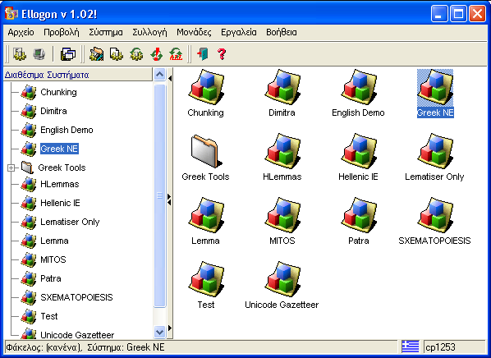
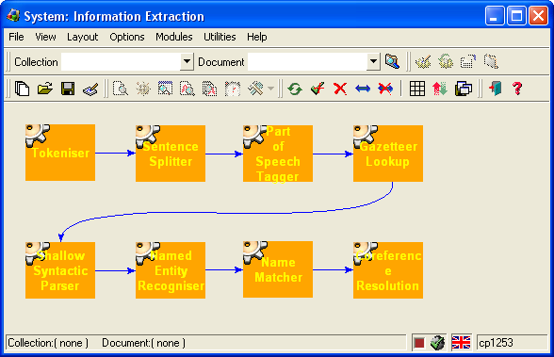
Ellogon Architecture
Language Processing Components
Graphical Interface
Internet
(HTTP, FTP, SOAP)
Operating System Services
(ActiveX, COM, DDE)
Database Connectivity
(ODBC)
…
Services
Collection – Document Manager
C++ API
C API
Storage Format Abstraction Layer
Operating System
XML
Ellogon
Databases
???

Slide 7
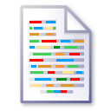
Ellogon Data Model
Attributes
Collection
language = Hellenic (string)
Document
...
Document
Document
Attributes
language = Hellenic (string)
bgImage = <binary data> (image)
Textual Data
Document
Information about Textual Data
Annotations
token
pos = noun
lemma = abc
co-reference
type = person
entity = 132

Slide 8
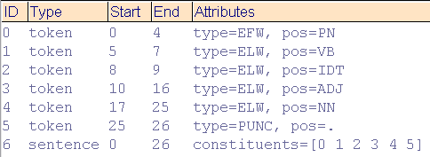
Annotations
Annotation
ID
Annotation ID
Unambiguously identifies the annotation within a document
0
Type
Annotation Type
Classifies annotations into categories
This is a simple sentence. 0....5....10...15...20...25
token
Annotations
Span Set
Annotation Span Set
Denotes ranges of annotated textual data
[0 4]
•••
Attribute Set
Annotation Attribute Set
Contains linguistic information in the form of named values
type = EFW
pos = PN
•••

Slide 9
The Collection
A C structure, containing (among other elements):
A Tcl list object, containing the documents to be deleted (if any)
A Tcl command token, holding the Tcl command that represents the collection at the Tcl level
A Tcl Hash table that contains the attributes of the collection. Each attribute is a Tcl list object
Two Tcl objects that can hold arbitrary information, such as notes and associated information

Slide 10
The Document
A C structure, containing (among other elements):
A Tcl command token, holding the Tcl command that represents the document at the Tcl level
A Tcl Hash table that contains the attributes of the document. Each attribute is a Tcl list object
A Tcl Hash table that contains the annotations of the document. Each annotation is either a Tcl list object, or an object of custom type

Slide 11
Attributes
Each attribute is a Tcl list object, containing three elements:
The attribute name: the name can be an arbitrary string
The type of the attribute value: this can be an item from a predefined set of value types
The value of the attribute, which can be an arbitrary (even binary) string

Slide 12
Annotations
An annotation is a Tcl object of custom type
It can be roughly seen as a list of four elements:
The annotation id: an integer, which uniquely identifies the annotation inside a document
The annotation type: an arbitrary string that classifies the annotation into a category
A list of spans: each span is a Tcl list object, holding two integers, the start/end character offsets of the text annotated by the span
A list of attributes: a Tcl list object, whose elements are attributes

Slide 13
The object cache
Ellogon implements a global memory cache for Tcl objects
Containing information from all opened collections and documents
The cache is used when:
Creating an element (i.e. attribute, span, annotation, etc.)
An annotation/attribute is put in a document
A collection/document is loaded

Slide 14
Why is cache important?
Linguistic information tents to repeat a lot
Example: annotating a 10.000 word document with a part-of-speech tagger
10.000 “token” annotations
Containing 10.000 “pos” attributes
Assume a tag set of 10 part-of-speech categories
Each “pos” value has a potential repetition in the thousands
Caching “token’ and “pos” makes sense
Caching larger clusters/constructs of objects makes even more sense
Sharing objects across document reduces memory consumption further

Slide 15
Thread safety (1)
The object cache is thread “unfriendly”
Tcl objects cannot be shared among threads
Parallel processing of documents is a highly desirable feature
But thread-safety is an open question for the Ellogon platform

Slide 16
Thread safety (2)
The CDM implementing the data model (and the object cache) is already thread-safe:
The global variables/objects are few, and their access is protected by mutexes
The object cache is global, and protected again with a mutex
Ellogon plug-in components use thread-specific storage for storing their “global” variables
Through special pre-processor definitions for C/C++ components
But thread-safety does not necessarily allow the usage of threads inside Ellogon

Slide 18
Can Ellogon become multi-threaded?
Difficult to be answered
Requirements are:
The graphical user interface must not block during component execution
It should be running in its own thread?
Each execution chain must run on its own thread
The documents of a collections should be distributed into N threads
And processed in parallel
This is a highly desired feature ☺

Slide 19
Obstacles for multiple threads
The object cache
Splitting it in multiple threads increases memory consumption
The GUI is also a viewer for linguistic data
If running in a separate thread, deep copy of objects is required
Plug-in components in Tcl
They frequently short-circuit the “API”, and tread API elements as Tcl lists
It is easier ☺

Slide 20
Conclusions
Ellogon has been in active development and usage for more than an decade now
Enhancements are required in order to exploit contemporary hardware better
However, it is unclear whether threads can be introduced
Without a major re-organisation of the platform
Without breaking compatibility with plug-in components
Any suggestions/ideas?

Slide 21
Thank you!

